Slide 1
Hello
Sandra Luksic (Philosophy ‘20)
Alexis Malone (Statistical Science ‘19)
Data + Women’s Spaces

Slide 2

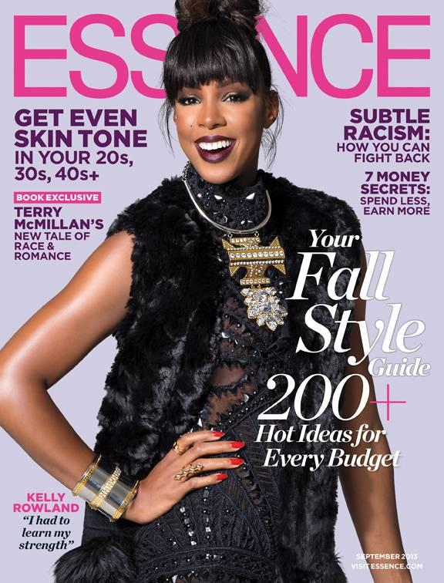
Data+ 2018: Project 6: Women’s Spaces
“Quantifying Representation in Women’s Magazines”
Nathan Liang, Sandra Luksic & Alexis Malone | Michelle Sroka, Charlotte Sussman, Ph.D.
Objective: Understand how representations of women in magazines reinforce/undermine gender norms. ​
Background: Popular magazines influence mainstream perceptions of women and how women see themselves by choosing who to feature on the cover, which products to advertise, and which points of view to represent.
Research Question: Which messages are pervasive in women’s and men’s magazines and how do these messages change over time, across magazines, and between different target audiences?
Data: 500+ covers from Cosmopolitan, Esquire, Essence, Good Housekeeping, Seventeen (Jan. 2010 - Jun. 2018)

Slide 3
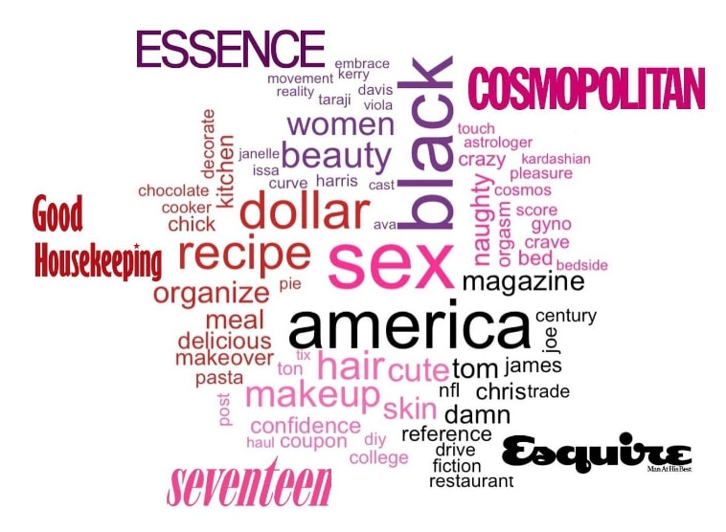
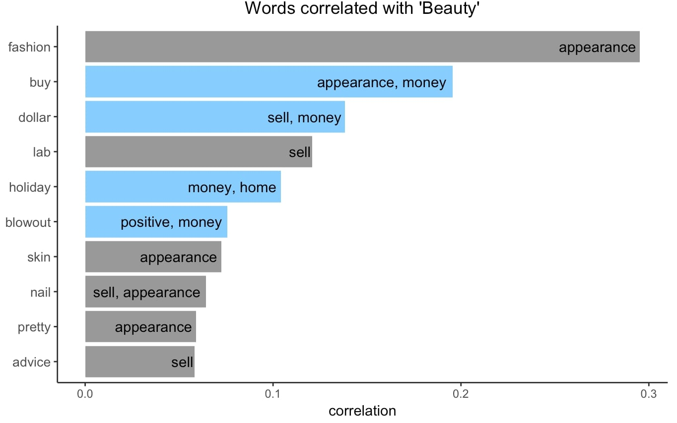
Text Analysis
Text was spell-checked, stemmed, removed of stop words and unrelated words.
We created a Magazine Sentiment dictionary for words specific to magazine/advertising because existing sentiment libraries didn’t have magazine/advertising industry specific meanings. Our sentiments included positive, negative, empowering, sex, sell-words, appearance, home, professional, male, female.
Figure 1: Tf-idf word cloud for all magazines shows the most common words unique to each magazine. Generally, women’s magazines emphasized beauty, sex, and domesticity, and Esquire​ emphasized patriotism and wealth for men. In addition, each magazine targets a specific audience and sends different messages. For example, Seventeen targets younger readers with lower budgets and uses budget-friendly words, whereas Good Housekeeping targets middle-aged women.
Figure 2: Words and Sentiments Correlated with "Beauty" Across all magazines, the word "beauty" is correlated with words related to money and selling products. Media and advertisers are able to generate a high demand for beauty products as a result of the demand for beauty. This is also indication of a woman’s value as a beauty and sex object. ​

Slide 4
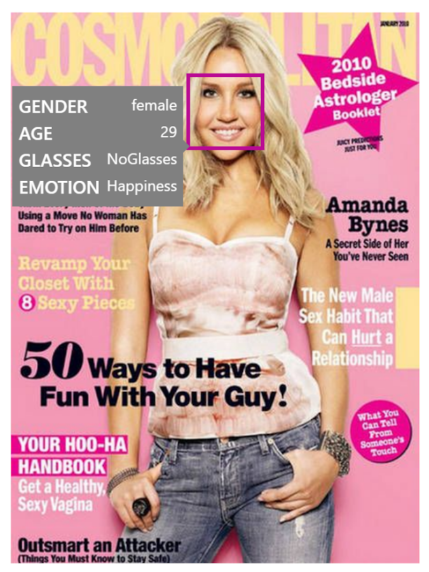
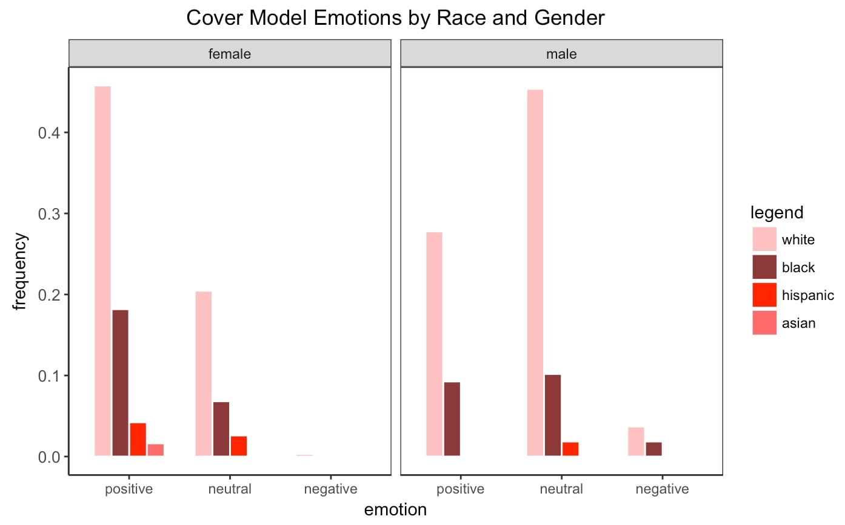
Image Analysis
Microsoft Azure Face Detect w/ Python identified cover model(s), perceived gender, age, emotion, and smile intensity​. We recorded race/ethnicity and hair length​.
Takeaways
Women’s magazines tend to reinforce gender norms and stereotypes. While each magazine caters to different audiences, the same messages are being conveyed to women across magazines (sex, beauty, domesticity, and women’s roles).
Do women’s magazines have a responsibility to empower women? If so, women’s magazines should include a more diverse representation of women and present a wider range of messages.
Figure 3: Men Exhibit More Emotional Variance​. Most female cover models display positive and some neutral emotions, whereas most male cover models display neutral emotions and exhibit the full range of positive, negative, and neutral emotions across magazines. This may be indication that men are viewed as more complex and sophisticated than women in magazines.
Magazine covers lack diversity​. Excluding Essence, 85% of cover models are white and appear to have below average body sizes​. Asian men are not represented in any magazine.

Slide 5
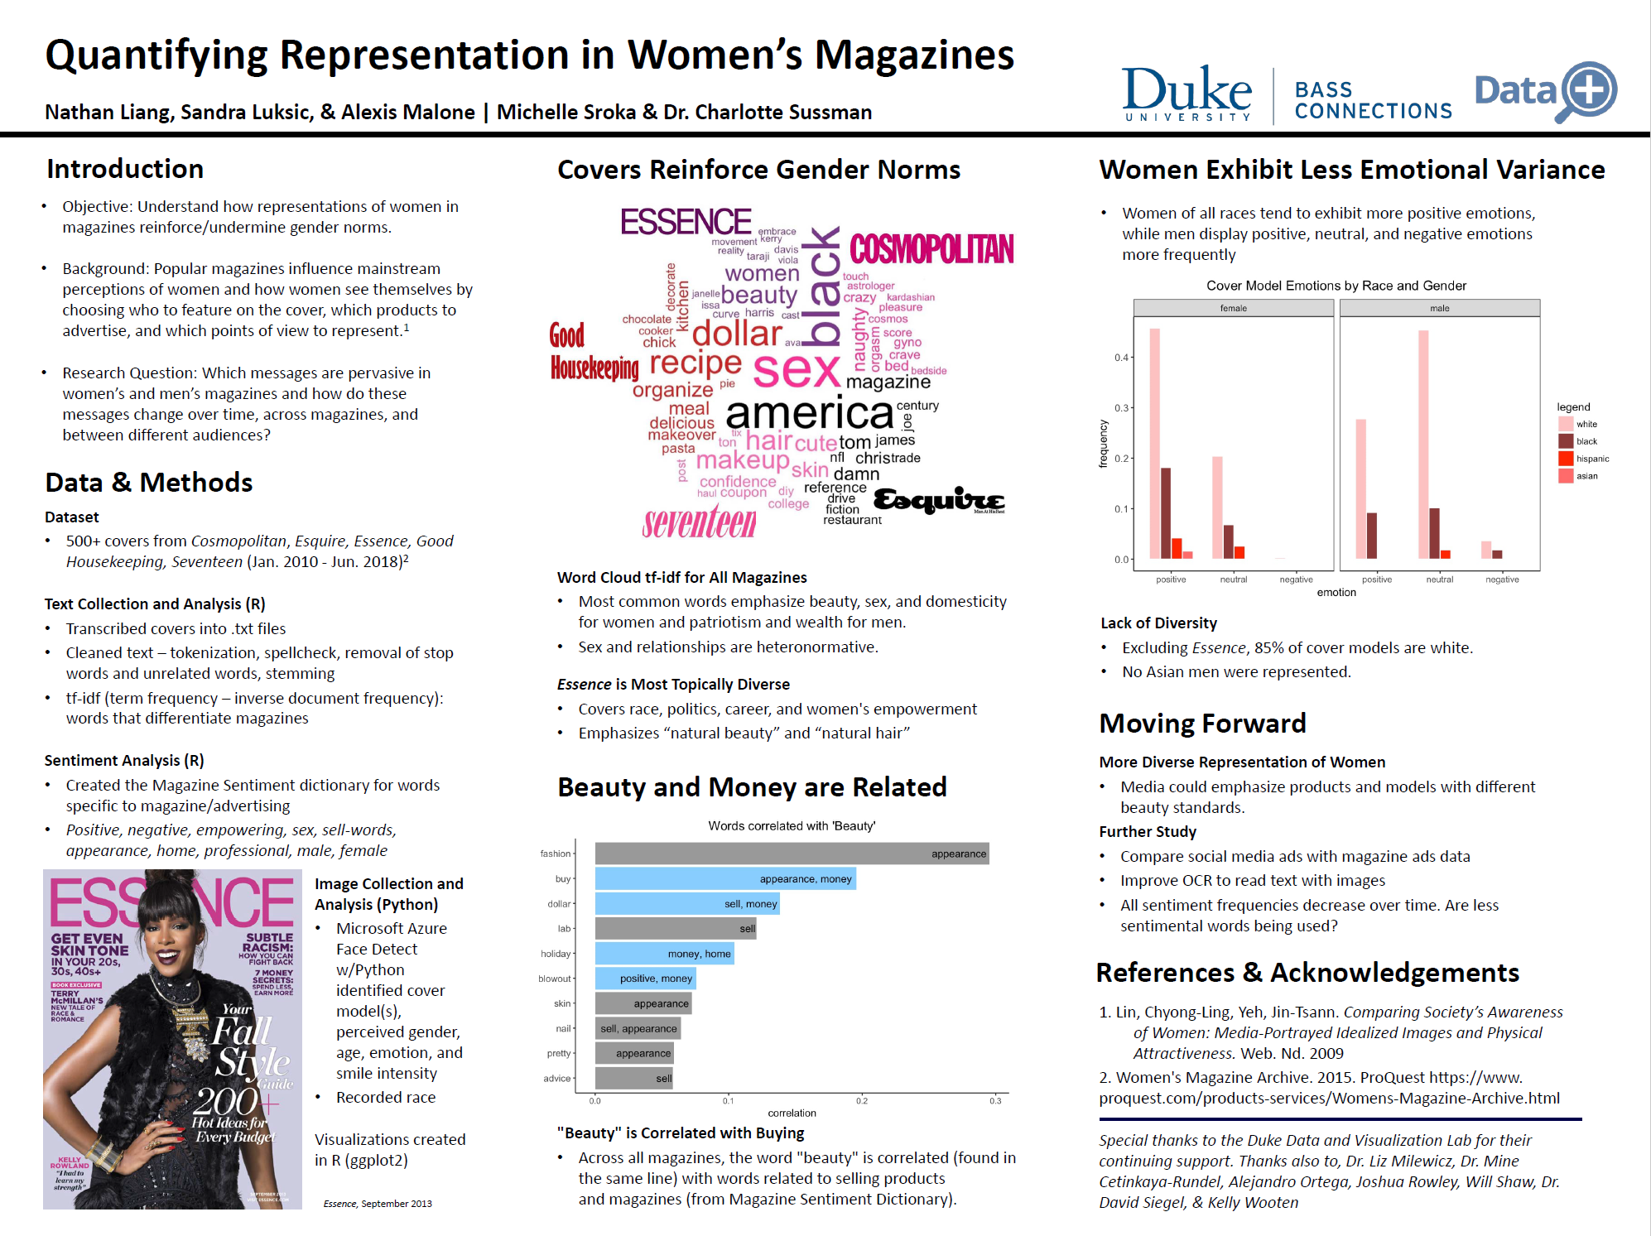

Slide 6
So…how do I start this?
⅔ members had no to little experience coding
⅔ members had no feminist/media background
No one had data science research experience

Slide 7
Resources we used
Duke University Librarians
Data Visualization Lab: The Edge 1-3pm
Professors
Peers
Brains and hearts

Slide 8
Words of Advice
Be dumb
Especially in new fields
Data is not objective
Data analysis is not always the easiest or best way forward

Slide 9

Apply for Data+ !

